Slide 1
GRA Implementations using Open Source Technologies
Mark Perbix and Yogesh Chawla
SEARCH

Slide 2

Goals
Quick review of Global Standards and Initiatives
Describe projects that have adopted and successfully implemented various Global Standards
Discuss advantages of using Open Source software

Slide 3
Global Standards and Initiatives
Global Reference Architecture (GRA)
Global Federated Identity and Privilege Management (GFIPM)
Global Technical Privacy Framework

Slide 4
Global Standards and Initiatives
Global Reference Architecture (GRA)
  National Information Exchange Model (NIEM)
  Governance – Policy and Technical Standards
Global Federated Identity and Privilege Management (GFIPM)
  Single Sign On
  Access Control
Global Technical Privacy Framework
  Privacy Policy Rules Enforcement

Slide 5
Focus
Global Reference Architecture (GRA)
  National Information Exchange Model (NIEM)
  Governance – Policy and Technical Standards
Global Federated Identity and Privilege Management (GFIPM)
  Single Sign On
  Access Control

Slide 6
GIST - Where does it all fit in?
Data
Messaging
Architecture
Access Control
Authentication
Federation
< Data >
Payload
Data
Transport
Structural Design
& IS Enablement
Data Disclosure
& Auditing
User Identification
& Credentialing
Security
Management
Underlying
Technology
Standard
XML
WS*
TCIP/IP
HTTP & HTTP/S
BPEL/XSLT
ebXML
XACML/SAML
AD & LDAP
Crypto
Trust Model
Trust Federation
Global Adaptation of Standard
NIEM
GRA
GFIPM
Global Technical Privacy Framework
Enablement of Interoperability
IEPDs
SSPs
SIPs
GFIPM Metadata
GFIPM Trust Model
Federation & FMO Definition
Communication Profiles
Manifestation in Your Implementation
IEPs
Services
SP Services
IdP Services
Participation in Federation
Adapters & Connectors
Intermediary & Service Registry
Notes:
We all understand why we need to share, but what is the best way to approach it? Flexible/strong/agile vs brittle/weak/clumsy, which to choose?

Slide 7
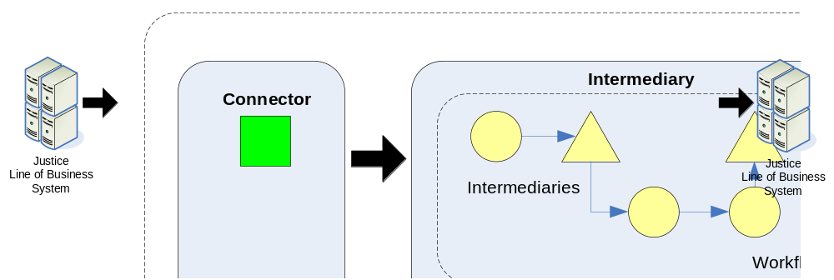
GRA - Technical Components
Notes:
The Global Reference Architecture (GRA) identifies a small but significant set of infrastructure components that are core to any GRA implementation. These components include:
Adapters: Components that implement the “provider” side of a service interaction, typically by receiving messages and interacting with a service provider agency’s internal systems or business processes.
Connectors: Components that implement the “consumer” side of a service interaction, typically by observing data changes or “triggers” in a consumer agency’s internal systems or business processes, and initiating a message transmission to a service provider.
Intermediaries: Special adapters that “mediate” information exchanges between participating organizations, performing such operations as transformations, routing, validation, and message aggregation; intermediaries reside on a broker, which exists in a “common space” between the partner organizations.
The communication between these components must adhere to the GRA Service Interaction Profiles (SIPs), which in practice means that interactions must be via standards-conformant Web Services protocols.

Slide 8
GRA Implementation Projects
Notification Service
  Interstate Compact for Adult Offender Supervision (ICAOS)
  Maine State Police Incident Reporting
Subscription Notification
  Hawaii Integrated Justice Information System (HIJIS)
Federated Query/Response with GFIPM
  Vermont Integrated Justice Information System Portal

Slide 9
ICAOS
Business Requirements
  Notify fusion centers (and potentially other law enforcement agencies) when a probation or parole offender relocates to another state.
Outcome
  Send notification through existing fusion center network infrastructure
  Notifications sent from outside the fusion center environment meeting security requirements

Slide 10
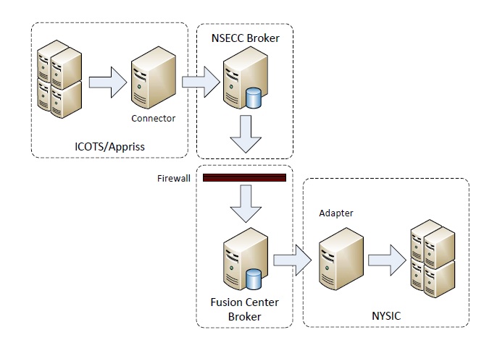
Relocation Notification Flow

Slide 11
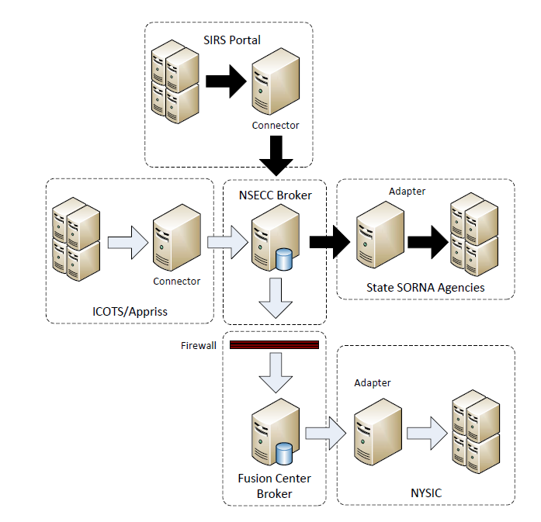
Add SIRS Flow

Slide 12
Maine State Police Incident Reporting
Business Requirements
  Incident Reports sent to N-DEx
  Case Referrals sent to Prosecutor
Outcomes
  Single Incident Record sent by police agencies to FBI and/or Prosecutor

Slide 13
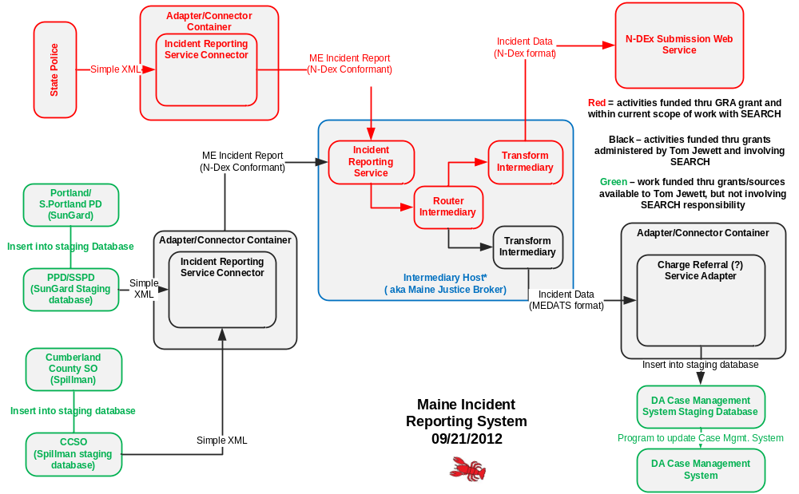
Maine State Police

Slide 14
HIJIS Notification of Re-arrest
Business Requirement
  Notify probation and parole officers when an offender is arrested for a new offense
Outcome
  Monitor statewide booking process and send a notification to parole and probation officers
  Subscriptions are automatically loaded from Parole and Probations systems

Slide 15
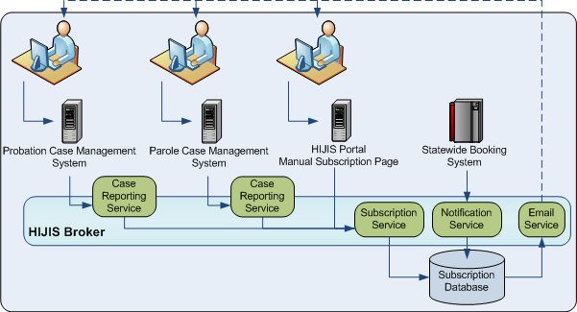
Subscription/Notification Flow

Slide 16
Vermont Federated Query
Business Requirement
  Provide access to incident records from all law enforcement agencies
  Support Single Sign-On access
Outcomes
  Enable users to access records in other agency RMSs using native credentials
  Implement Entity Resolution capabilities to merge persons or vehicles that do not have unique identifiers

Slide 17
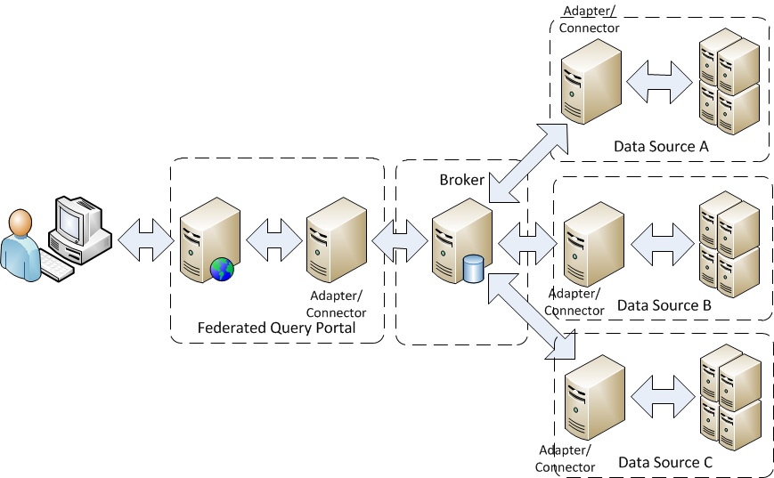
Federated Query with Entity Resolution

Slide 18
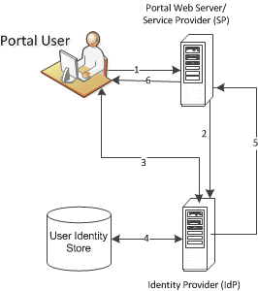
Single Sign On

Slide 19
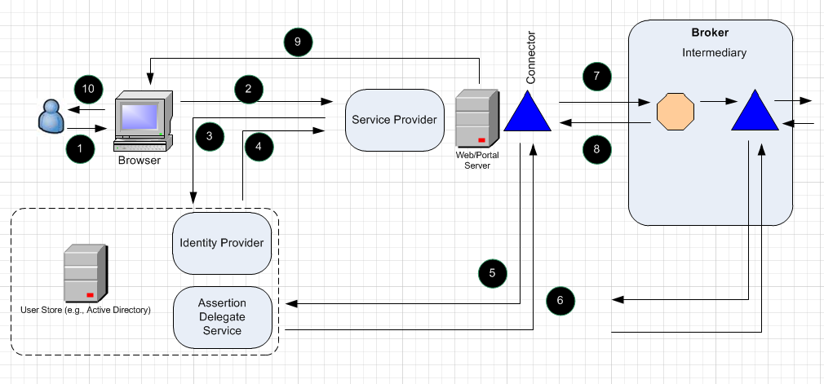
System-to-System Authentication
Notes:
1. User requests access to web application, hosted on the “Web Portal Server”, via a web browser.
2. Web browser redirects the user’s HTTP request to the Service Provider for the Web Portal Server.
3. If the Service Provider does not have a session for the user, it redirects the user’s web browser to the user’s Identity Provider, which prompts the user to authenticate. Note that the Identity Provider is the sole place in the HIJIS environment where the user’s credentials are maintained; this will generally be at the user’s home agency.
4. Following authentication, the Identity Provider forms an assertion for the user and redirects the user’s web browser back to the Service Provider. The redirected HTTP request contains the assertion in an HTTP header. The Service Provider forms a session for the user, and redirects the user’s web browser back to the originally requested web application page.
5. The web application, which contains a Connector, forms a WS-Trust Request Security Token Request (RSTR) and sends the request to a GFIPM Assertion Delegate Service (ADS). An ADS is a special-purpose WS-Trust Security Token Service (STS), defined by GFIPM. The RSTR contains the original assertion obtained at the IdP in step 3.
6. The ADS forms a new SAML assertion and sends it back to the Connector.
7. The Connector includes the new SAML assertion in its web service message to the Intermediary.
8. The intermediary services the web service request and returns a response.
9. The web application returns the web page to the user’s web browser
10. The user’s web browser displays the web page to the user

Slide 20
Open Source Technology Option
Apache Foundation
  ServiceMix
  Camel
  CXF
Advantages
  Compliance with Standards
  No upfront licensing
  Broad community of support
  No vendor “lock-in”
  Maintainability

Slide 21
Sustainability Options
Develop internal expertise
Rely on outside resources
  Why?
  Many options
Shared support - cooperative
Notes:
Why? Limited amount of work needed to support GRA components
Many options – open source software is supported by many vendors and service providers – avoids vendor lock-in.

Slide 22

What is the OJBC?
Non-profit consortium of state and local jurisdictions to support reuse and sharing of technology
States of Hawaii, Vermont and Maine are the initial members
Goals of the consortium:
  Integrate contributions from member states into a single, reusable platform
  Provide shared expert staff resources
  Enable use of low-cost, open source technology

Slide 23
Benefits of the OJBC
Commonality across states creates significant opportunity for reuse
  Don’t reinvent the wheel
  Learn from one another
  Save time and money
National standards create the basis for a common technology platform
Technology is powerful, but complex and costly to own and operate in isolation
Continues a long tradition of collaboration among jurisdictions

Slide 24
Questions?
“The only one thing you can always count on is that everything will always change”
- Unknown
Contact Information
Mark Perbix
Director, Information Sharing Programs
mark.perbix@search.org
916-712-5918
Yogesh Chawla
Information Sharing Architecture Specialist
Yogesh.chawla@search.org
608-438-5965

